Slide 1
Dependency Injection by Constructor - Injecting int and string values
We can inject the dependency by constructor.
The <constructor-arg> sub-element of <bean> is used for constructor injection.
We can inject
primitive and String-based values
Dependent object (contained object)
Collection values etc.

Slide 2
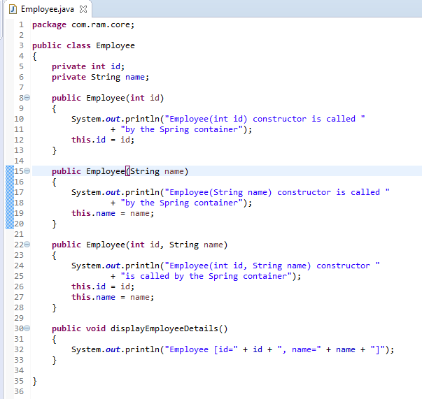
Dependency Injection by Constructor - Injecting int and string values

Slide 3
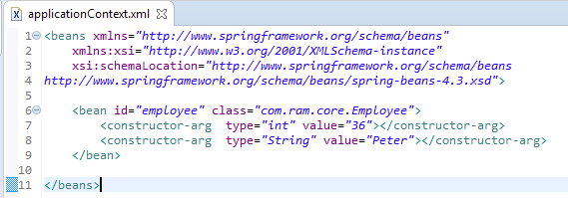
Dependency Injection by Constructor - Injecting int and string values
We are providing the information into the bean by applicationContext.xml file.
The constructor-arg element invokes the constructor.The type attributes specifies that int and String parameter constructor will be invoked. In this example Employee(int id, String name) constructor will be invoked.

Slide 4
Dependency Injection by Constructor - Injecting int and string values
Create employee object
Configure the employee object
Manage employee object complete life cycle from creation till destruction.
Employee
What object to instantiate?
What object to configure and how to configure?
The Spring Container
(ApplicationContext)
applicationContext.xml
Employee
Object
Id=36
name=“Peter”

Slide 5
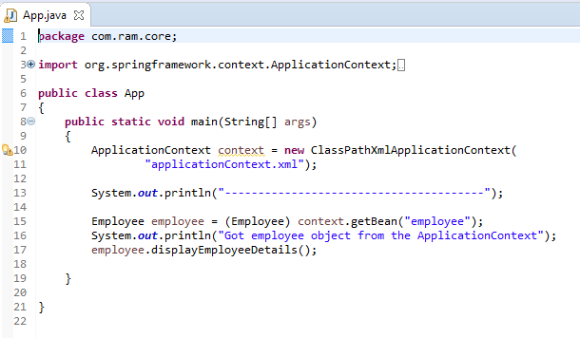
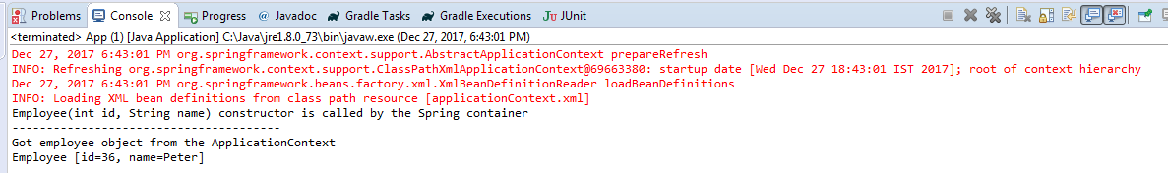
Dependency Injection by Constructor - Injecting int and string values

